Slide 1
System Development Methods CT00046-3-2
Process Oriented Methodologies

Slide 2
Topic & Structure of the Lesson
Process Oriented Methodologies
Rapid Application Development (RAD)
Rational Unified Process (RUP)
SCRUM
Extreme Programming (XP)
Spiral Methods

Slide 3
Learning Outcomes
By the end of this lecture, YOU should be able to :
Identify and explain the underlying process based methodologies

Slide 4
Key Terms you must be able to use
If you have mastered this topic, you should be able to use the following terms correctly in your assignments and exams:
Process Oriented Methodologies
Rapid Application Development (RAD)
Rational Unified Process (RUP)
SCRUM
Extreme Programming (XP)
Spiral Methods

Slide 5
Process Oriented Methodologies
The proposed methodology can be applied to complex and distributed business processes.
The business process is converted into functions in a system.
Steps of Methods;
Business process is studied
Processes and tasks are broken down into smallest workable component.
Each sub-process can be assigned a time, cost and resources for it to complete.
This can be shown in planning charts such as Gantt Chart, PERT Chart, Task Breakdown Structure, etc.

Slide 6
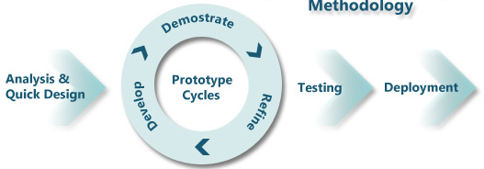
Rapid Application Development (RAD)
‘Fast’ methodology for fast / urgent projects
Within days / weeks

Slide 7

Rapid Application Development (RAD) Techniques
Expert developers used
Uses tools (CASE Tools) for faster development and testing
Uses minimal planning, analysis and documentation
Uses Prototype for user feedback & review, product development
Iterative and Incremental design approach with prototyping
Users are involved in development

Slide 8
Rational Unified Process (RUP)
“plan a little, design a little, and code a little”
Very careful development method, emphasis on quality of product and process.
Extensive and exclusive use of UML, direct support for OO Programming.
Takes a holistic approach of the system;
Architecture of the system determined
Task broken-down to smaller components.
Iterative & incremental approach applied to do all tasks.

Slide 9
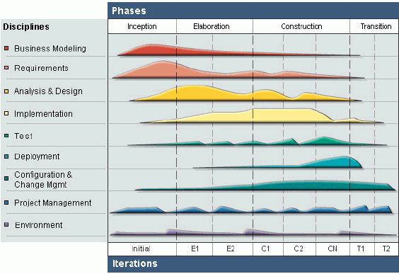
Rational Unified Process (RUP)

Slide 10
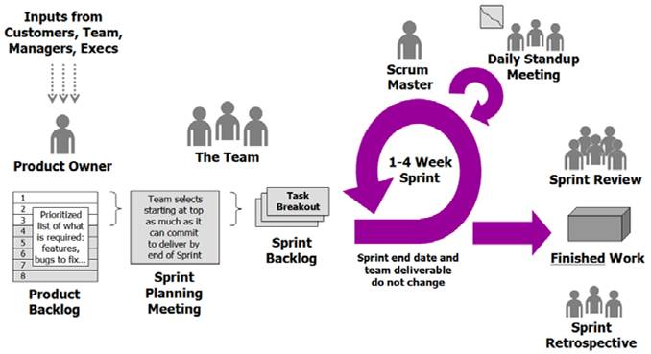
Scrum Methodology
A ‘team-work’ based methodology.

Slide 11

Scrum Methodology Key Concepts
User Stories – developer & user come up with general concept of the system
Product Owner - determines that the business requirements are met
Development Teams are from mixed skills
Scrum Master helps to solve the ‘gaps’ in the project such as solving problems or giving ideas.
Sprint – a cycle of a task to be performed in the project.
Backlogs – this need to be for the project to be completed.

Slide 12
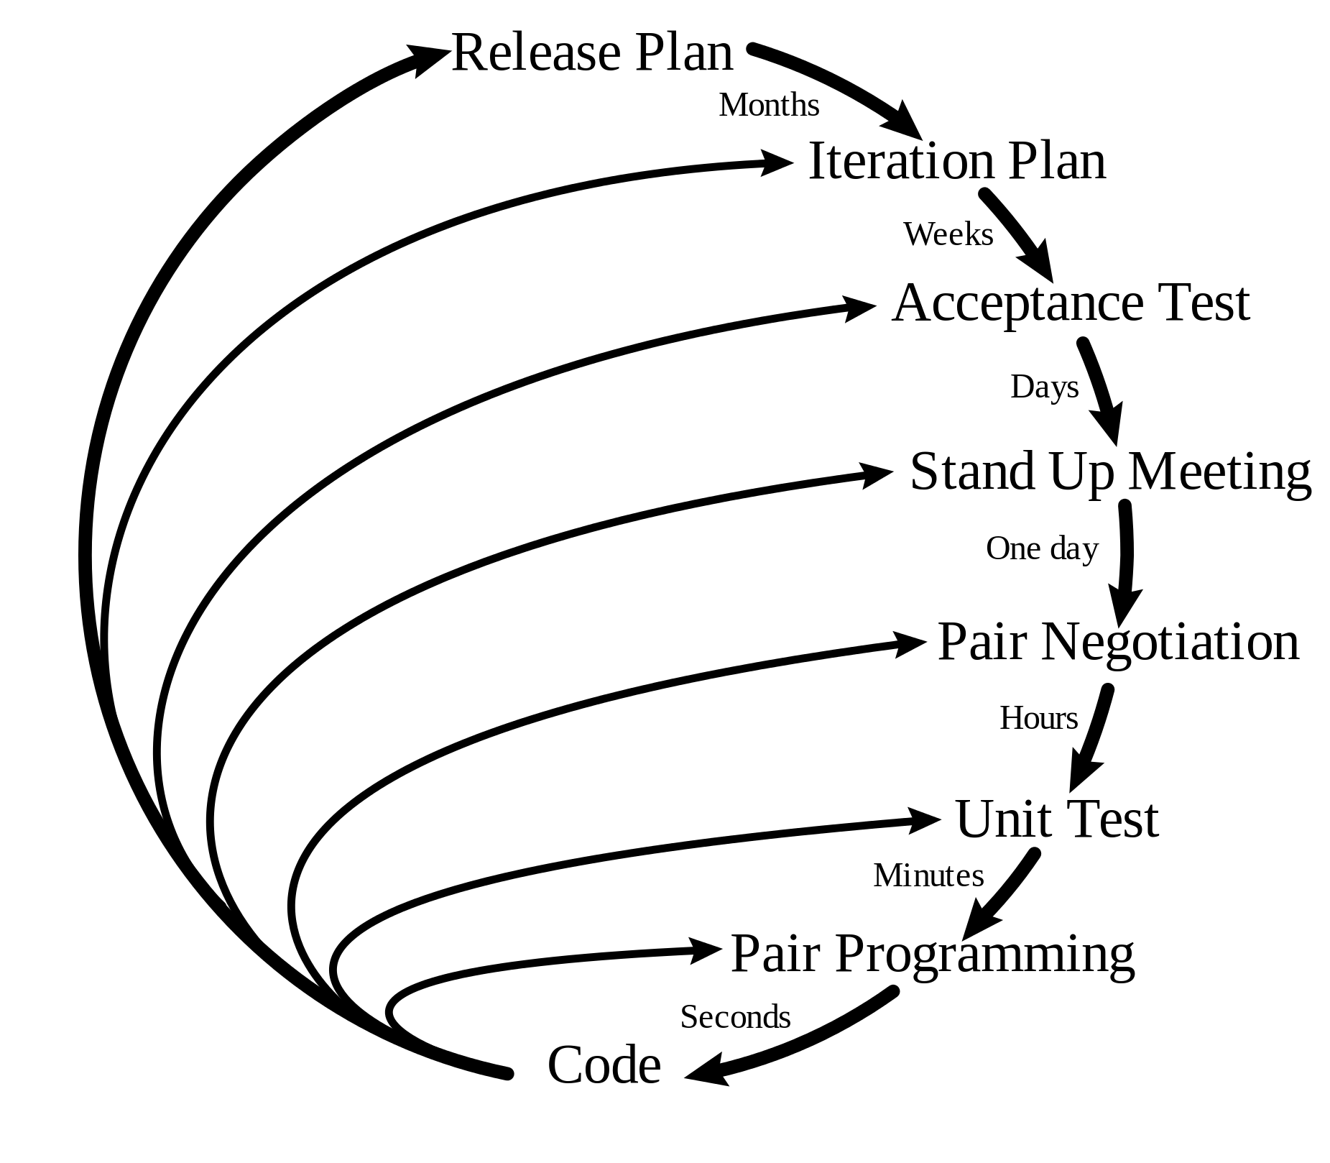
Extreme Programming (XP)
Very flexible methodology.
Effective Programming / coding approach.
For projects involving heavy coding / software building
Uses most of the Agile Principles

Slide 13

Extreme Programming (XP) Techniques
Small and frequent "releases" in short development cycles
Development team – fully integrated
Pair programming, stand-up meetings
Test driven development
Close user involvement , testing
Accept changing requirement at any time
Simplicity in everything
Tries to simplify all processes
Produce high quality software.
… and other Agile Principles applied.

Slide 14
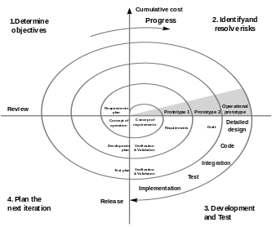
Spiral Methods
“Risk-driven” process model. The next steps to be done is determined based on the ‘Risk’ pattern.
For projects which has high risk;
Unclear / unfixed requirements
Projects has too many independent components
Projects have too many stakeholders which don’t agree with things.

Slide 15
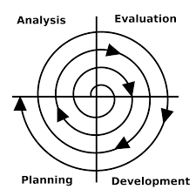
Spiral Methods Phases
Planning Phase
Requirements are gathered.
Specification are set.
Risk Analysis
Identify risk and alternate solutions.
A prototype is produced
Engineering Phase
Software is developed
Through Testing carried out.
Evaluation phase
Allows the customer to evaluate the output of the project to date before the project continues to the next spiral.

Slide 16
Quick Quiz
Briefly explain the following techniques;
Iterative approach
Incremental approach
Pair-programming

Slide 17
Question & Answer

Slide 18
Next Session
System Development Planning – Part-1

Slide 19
Tutorial
Draw a table and show how the methodologies that you have learned is adopting Agile Principles. Example;
2. Discuss TWO disadvantages of each methodologies you learned in this slide.
Agile Principles | RAD | XP | SCRUM
Customer satisfaction | Yes | No | No …….

